Slide 1
Decision Tree Learning

Slide 2
Contents
Introduction
Decision Tree Representation
APPROPRIATE PROBLEMS FOR DECISION TREE LEARNING
THE BASIC DECISION TREE LEARNING ALGORITHM
HYPOTHESIS SPACE SEARCH IN DECISION TREE LEARNING
INDUCTIVE BIAS IN DECISION TREE LEARNING
ISSUES IN DECISION TREE LEARNING

Slide 3
Introduction
It is a method that uses inductive inference to approximate a target function, which will produce discrete values (Discrete data can only take particular values. ... Discrete data can be numeric -- like numbers of apples -- but it can also be categorical -- like red or blue, or male or female, or good or bad.).
Inductive inference is the process of reaching a general conclusion from specific examples.
Inductive Learning Hypothesis: any hypothesis found to approximate the target function well over a sufficiently large set of training examples will also approximate the target function well over other unobserved examples.
It is widely used, robust to noisy data, and considered a practical method for learning disjunctive expressions.

Slide 4
Appropriate Problems for Decision Tree Learning
Decision tree learning is generally best suited to problems with the following characteristics:
Instances are represented by attribute-value pairs (temperature = Hot)
The target function has discrete output values. (categorical or numerical)
Disjunctive descriptions may be required.
The training data may contain errors.
The training data may contain missing attribute values.
After a decision tree learns classification rules, it can also be re-represented as a set of if-then rules in order to improve readability.

Slide 5
Decision Tree Representation
Decision trees classify the instances by sorting them down the tree from the root node to some leaf node, which provides the classification of the instance.
Each node in the tree specifies a test of some attribute of the instance and each branch descending from that node corresponds to one of the possible values for this attribute.
An instance is classified by starting at the root node of the tree, testing the attribute specified by this node, then moving down the tree branch corresponding to the value of the attribute in the given example.
This process is then repeated for the subtree rooted at the new node.
Next- Decision tree for concept PAYTENNIS

Slide 6
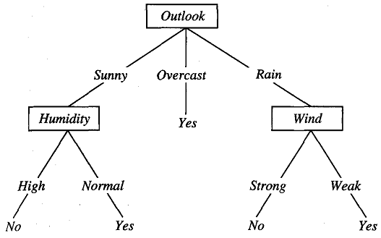

Slide 7
Contd.
In general, Decision trees represent a disjunction of conjunctions of constraints on the attribute values of instances.
Each path from the tree root to a leaf corresponds to a conjunction of attribute tests and the tree itself to a disjunction of these conjunctions.
For example, the decision tree shown in figure corresponds to the expression
(Outlook = Sunny ^ Humidity = Normal)
V
(Outlook = Overcasts)
V
(Outlook = Rain ^ Wind = Weak)

Slide 8
The Basic Decision Tree Learning Algorithms
ID3 algorithm ( Quinlan 1986)
C4.5 algorithm ( Quinlan 1993)
ASSISTANT
CART

Slide 9
ID3 Algorithm
ID3 algorithm learns decision trees by constructing them top-down.
It begins with the Question
“Which attribute should be tested at the root of the tree?”
Each instance attribute is evaluated using a statistical test to determine how well it alone classifies the training examples.
Best attribute is selected & used as the test at the root node of the tree
A descendant of the root node is then created for each possible value of this attribute & the training examples are sorted to the appropriate descendant node

Slide 10
Which Attribute is the Best Classifier?
By using Statistical Property, called “Information gain” that measures how well a given attribute separates the training examples according to their target classification.
ID3 uses this information gain measure to select among the candidate attribute at each step while growing the tree

Slide 11
Entropy Measures Homogeneity of Examples
To define Information Gain, we need entropy.
Entropy characterizes the (im) purity of an arbitrary collection of examples
Given a collection S, containing positive & negative examples of some target concept, the entropy of S relative to this boolean classification is
Entropy(S) = -p⊕ log₂ p⊕ - p_{Ө} log₂ p_{Ө}
p⊕ is the proportion of positive examples in S
p_{Ө} is the proportion of negative examples in S

Slide 12
ID3 Iterative Dichotomizer 3
ID3 (Examples, Target_Attribute, Attributes) Create a root node for the tree If all examples are positive, Return the single-node tree Root, with label = +. If all examples are negative, Return the single-node tree Root, with label = -. If number of predicting attributes is empty, then Return the single node tree root, with label = most common value of the target attribute in the examples.

Slide 13
Otherwise
A ← The Attribute that best classifies examples.
Decision Tree attribute for Root = A.
For each possible value, v_{i}, of A,
Add a new tree branch below Root, corresponding to the test A = v_{i}. Let Examples(v_{i}) be the subset of examples that have the value v_{i} for A If Examples(v_{i}) is empty
Then below this new branch add a leaf node with label = most common target value in the examples
Else
below this new branch add the subtree
ID3 (Examples(v_{i}), Target_Attribute, Attributes– {A}) End Return Root

Slide 14

Calculate the best attribute or Information Gain
Suppose S is a collection of 14 examples of some boolean
concept, including 9 positive and 5 negative examples (we adopt the notation
[9+, 5-1 to summarize such a sample of data). Then the entropy of S relative to
this boolean classification is:

Slide 15
Note..
Notice that the entropy is 0 if all members of S belong to the same class.
For example, if all members are positive (p+ = I), then p-, is 0, and
Entropy(S) = -1 .log2(1)- 0 .log20 = -1 .0- 0 .log20 = 0.
Note the entropy is 1 when the collection contains an equal number of positive and negative examples.
If the collection contains unequal numbers of positive and negative examples, the entropy is between 0 and 1.

Slide 16
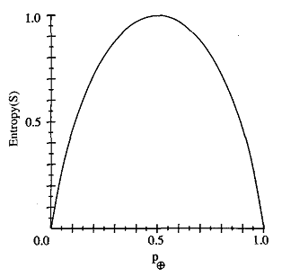
The entropy function relative to a boolean classification as the proportion, p+, of positive examples varies between 0 and 1

Slide 17

Information Gain
We can now define a measure of the effectiveness of an attribute in classifying the training data
Information gain, is the expected reduction in entropy caused by partitioning the examples according to this attribute.
The information gain, Gain(S,A) of an attribute A
Values(A) is the set of all possible values for attribute A
Sv is the subset of S for which attribute A has value v

Slide 18
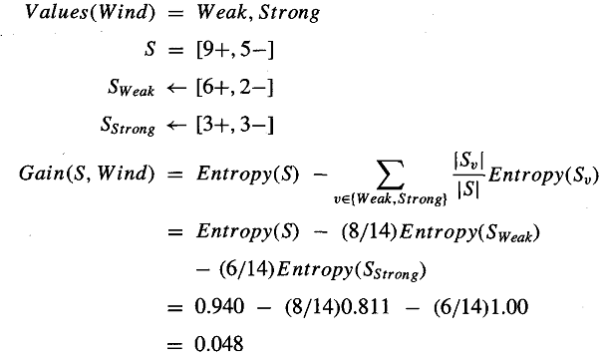
Example

Slide 19
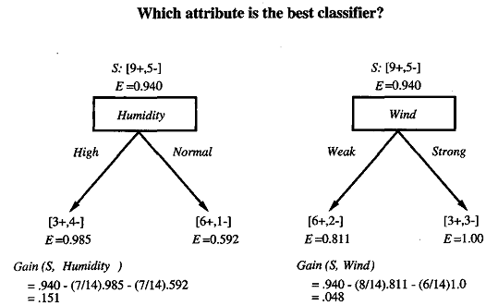

Slide 20
Day | Outlook | Temperature | Humidity | Wind | PlayTennis
1 | Sunny | Hot | High | Weak | No
2 | Sunny | Hot | High | Strong | No
3 | Overcast | Hot | High | Weak | Yes
4 | Rain | Mild | High | Weak | Yes
5 | Rain | Cool | Normal | Weak | Yes
6 | Rain | Cool | Normal | Strong | No
7 | Overcast | Cool | Normal | Strong | Yes

Slide 21
Day | Outlook | Temperature | Humidity | Wind | PlayTennis
8 | Sunny | Mild | High | Weak | No
9 | Sunny | Cool | Normal | Weak | Yes
10 | Rain | Mild | Normal | Weak | Yes
11 | Sunny | Mild | Normal | Strong | Yes
12 | Overcast | Mild | High | Strong | Yes
13 | Overcast | Hot | Normal | Weak | Yes
14 | Rain | Mild | High | Strong | No

Slide 22
Gain(S,Outlook) = 0.246
Gain(S,Humidity) = 0.151
Gain(S,Wind)= 0.048
Gain(S,Temperature) = 0.029

Slide 23
Consider the following set of training
What is the entropy of this collection of training examples with respect to the target function classification?
What is the IG of a2 relative to those training examples?
Instance | Classification | a1 | a2
1 | + | T | T
2 | + | T | T
3 | - | T | F
4 | + | F | F
5 | - | F | T
6 | - | F | T

Slide 24
HYPOTHESIS SPACE SEARCH IN DECISION TREE LEARNING
The hypothesis space searched by ID3 is the set of possible decision trees
ID3 performs a simple-to-complex, hill-climbing search through this hypothesis space, beginning with the empty tree, then
Considering progressively more elaborate hypotheses in search of a decision tree that correctly classifies the training data

Slide 25
HYPOTHESIS SPACE SEARCH IN DECISION TREE LEARNING
Hypothesis Space: Set of possible decision trees (i.e., complete space of finite discrete-valued functions).
Search Method: Simple-to-Complex Hill-Climbing Search (only a single current hypothesis is maintained (≠ from candidate-elimination method)). No Backtracking!!!
Evaluation Function: Information Gain Measure
Batch Learning: ID3 uses all training examples at each step to make statistically-based decisions (≠ from candidate-elimination method which makes decisions incrementally). ==> the search is less sensitive to errors in individual training examples.

Slide 26
INDUCTIVE BIAS IN DECISION TREE LEARNING
What is the policy by which ID3 generalizes from observed training examples to classify unseen instances?
ID3 search strategy
(a) selects in favor of shorter trees over longer ones, and
(b) selects trees that place the attributes with highest information gain closest to the root.

Slide 27
Restriction Biases and Preference Biases
The inductive bias of ID3 is a preference for certain hypotheses over others (e.g., for shorter hypotheses). This form of bias is typically called a preference bias
In contrast, the bias of the CANDIDATE ELIMINATION algorithm is in the form of a categorical restriction on the set of hypotheses considered. This form of bias is typically called a restriction bias.

Slide 28
ISSUES IN DECISION TREE LEARNING
Avoiding Overfitting the Data
Incorporating Continuous-Valued Attributes
Alternative Measures for Selecting Attributes
Handling Training Examples with Missing Attribute Values

Slide 29
Avoiding Overfitting the Data
The ID3 algorithm described earlier grows each branch of the tree just deeply
enough to perfectly classify the training examples.
While this is sometimes it can lead to difficulties when there is noise in the data,or
when the number of training examples is too small to produce a target function
Definition:
Given a hypothesis space H, a hypothesis h E H is said to overlit the
training data if there exists some alternative hypothesis h' E H, such that h has smaller error than h' over the training examples, but h' has a smaller error than h over the entire distribution of instances.
Hence h is overfits the data.

Slide 30
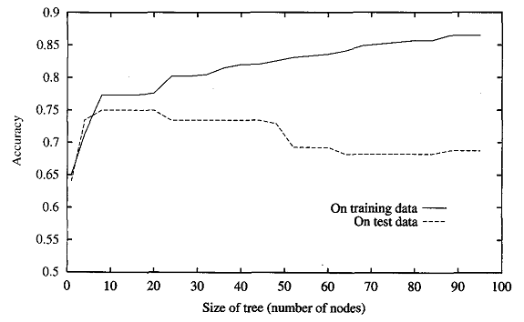
Overfitting in decision learning tree with ID3

Slide 31
Overfitting can occur is when the training examples contain random errors or noise
There are several approaches to avoiding overfitting in decision tree learning.
approaches that stop growing the tree earlier
post-prune the tree
Validation Approaches after applying above options:
REDUCED ERROR PRUNING
RULE POST-PRUNING

Slide 32
REDUCED ERROR PRUNING
is to consider each of the decision nodes in the.tree to be candidates for pruning.
Pruning a decision node consists of removing the subtree rooted at that node, making it a leaf node, and assigning it the most common classification of the training examples affiliated with that node.
The pruned tree is considered if it performs better than the original tree.
Pruning of nodes continues until further pruning is harmful (i.e., decreases accuracy of the tree over the validation set)

Slide 33
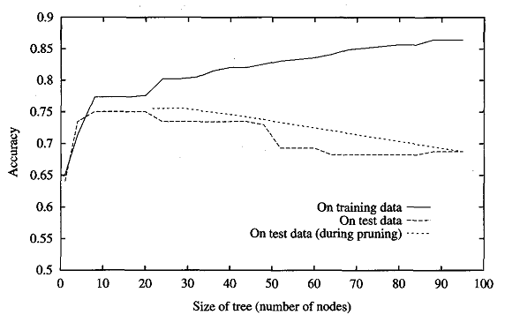
Effect of reduced-error pruning in decision tree learning

Slide 34
RULE POST-PRUNING
Rule post-pruning involves the following steps:
Infer the decision tree from the training set, growing the tree until the training data is fit as well as possible and allowing overfitting to occur
Convert the learned tree into an equivalent set of rules by creating one rule for each path from the root node to a leaf node.
Prune (generalize) each rule by removing any preconditions that result in improving its estimated accuracy.
Sort the pruned rules by their estimated accuracy, and consider them in this sequence when classifying subsequent instances.

Slide 35

2. Issue- Incorporating Continuous-Valued Attributes
Our initial definition of ID3 is restricted to attributes that take on a discrete set of values
This restriction can easily be removed so that continuous-valued decision attributes can be incorporated into the learned tree
There are two candidate thresholds, corresponding to the values of Temperature at which the value of PlayTennis changes: (48 + 60)/2, and (80 + 90)/2.
The information gain can then be computed for each of the candidate attributes, temp>54 and temp>85,and the best can be selected.

Slide 36
3.Issue - Alternative Measures for Selecting Attributes
There is a natural bias in the information gain measure that favors attributes with many values over those with few values.
As an extreme example, consider the attribute Date, which has a very large number of possible values.
Date alone perfectly predicts the target attribute over the training data. Thus, it would be selected as the decision attribute for the root node of the tree
It is not a useful predictor despite the fact that it perfectly separates the training data.
One way to avoid this difficulty is to select decision attributesbased on some measure other than information gain
GainRatio(S, A) = Gain(S, A) / SplitInformation(S, A)

Slide 37
4-Issue-Handling Training Examples with Missing Attribute Values
Suppose that ( x ,c ( x ) )is one of the training examples in S and that the value A(x) is unknown
One strategy for dealing with the missing attribute value is to assign it the value that is most common among training examples at node n

Slide 38
5-Issue-Handling Attributes with Differing Costs
In some learning tasks the instance attributes may have associated costs.
In such tasks, we would prefer decision trees that use low-cost attributes where possible, relying on high-cost attributes only when needed to produce reliable classifications.
A robot perception task in which the robot must learn to classify different objects according to how they can be grasped by the robot's manipulator.
Attribute cost is measured by the number of seconds required.

